Slide 1


Khairil Azmi Ashari
10 August 2022

Slide 2
Outline
Executive Summary
Introduction
Methodology
Results
Conclusion
Appendix

Slide 3

Executive Summary
In this project we do data collection methodology using SpaceX API and Web scraping. Then, Perform data wrangling do data analysis, deal with missing value, and then create label for success/failure landing outcome. Perform exploratory data analysis (EDA) using visualization and SQL. Performing interactive visual analytics using Folium and Plotly Dash, then finally perform predictive analysis using classification models using Logistic Regression, Support Vector, Decision Tree, and K-Nearest to predict launch result and find which classification model give the best accuracy for result.
SpaceX launch sucess rate since 2013 kept increasing till 2020. ES-L1, GEO, HEO, and SSO orbit type had 100% success rate. KSC LC-39A had highest success rate with 76.9% success rate and it seen on the map data. Payload range 2k-5k is the optimize size payload for success land with FT Booster Version had the highest success count. Decision Tree had the highest best accuracy classification with 0.8889 or equal to 88.89% Accuracy.

Slide 4

Introduction
Space X have project Starlink, a satellite internet constellation providing satellite Internet access. Sending manned missions to Space. One reason SpaceX can do this is the rocket launches are relatively inexpensive. SpaceX advertises Falcon 9 rocket launches on its website with a cost of 62 million dollars. other providers cost upwards of 165 million dollars each, much of the savings is because. SpaceX can reuse the first stage.
Therefore, if we can determine if the first stage will land, we can determine the cost of a launch. This information can be used if an alternate company wants to bid against SpaceX for a rocket launch.

Slide 5

Section 1

Slide 6
Methodology
Executive Summary
Data collection methodology:
Here we collect data using 2 method SpaceX API and Web scraping.
Perform data wrangling
Here we do data analysis, deal with missing value, and then create label for success/failure landing outcome.
Perform exploratory data analysis (EDA) using visualization and SQL
Perform interactive visual analytics using Folium and Plotly Dash
Perform predictive analysis using classification models
Here we use Logistic Regression, Support Vector, Decision Tree, and K-Nearest to predict launch result and find which classification model give the best accuracy for result.

Slide 7

Data Collection
Data sets were collected using SpaceX API and Web scraping from Wikipedia about List of Falcon 9 Falcon Heavy Launches.
SpaceX API process Flowchart
Web Scraping process Flowchart
Request SpaceX data
Parse data
Collect data to data frame
Request Wiki page
Extract all column/variable
Create data frame

Slide 8
Data Collection – SpaceX API
Link Process
Data Collection - SpaceX API
Request SpaceX data
Parse data
Collect data to data frame

Slide 9
Data Collection - Scraping
Link process :
Data Collection - Web scraping process
Request Wiki page
Extract all column/variable
Create data frame

Slide 10
Data Wrangling
In data wrangling, We do Data Analysis first we detect any missing value then dealing with it. We do 'mean' with missing Payload Mass value, We do nothing on Landing Pad because we don't need it, then we count every value to see unique Launch site, Orbit, Outcome . Finally Create a landing outcome (Class) label from Outcome column to inform success or failure landing.
Data Wrangling process:
Data Wrangling Process
Creating Landing class
Deal with missing value
Data Analysis

Slide 11
EDA with Data Visualization
First we plot Flight Number vs. Payload Mass as the flight number increases, the first stage is more likely to land successfully. The payload mass is also important; it seems the more massive the payload, the less likely the first stage will return.
Launch site vs Flight Number, show as the flight number above 80 all launches identify as success launch. In Payload Vs. Launch Site scatter point chart you will find for the VAFB-SLC launch site there are no rockets launched for heavy payload mass(greater than 10000).
ES-L1, GEO, HEO, and SSO orbit type had 100% success rate. On the other hand SO orbit had 0% success rate. LEO orbit the Success appears related to the number of flights.
With heavy payloads the successful landing or positive landing rate are more for Polar, LEO and ISS. And finally from last plot you can observe that the sucess rate since 2013 kept increasing till 2020
EDA with Data Visualization Proccess

Slide 12

EDA with SQL
First we do Mark all launch sites on U.S. map to see position of launch sites, Then Mark the success/failed launches for each sites to see launch result from map, and last we calculate the distances between a launch site to its proximities.
All the proximities created are closest coast, highway, railroad, and city, to see how launch sites created far enough from surrounding, to keep safety of people.
Interactive Map with Folium Process

Slide 13
Build an Interactive Map with Folium
First we do Mark all launch sites on U.S. map to see position of launch sites, Then Mark the success/failed launches for each sites to see launch result from map, and last we calculate the distances between a launch site to its proximities.
All the proximities created are closest coast, highway, railroad, and city, to see how launch sites created far enough from surrounding, to keep safety of people.
Interactive Map with Folium Process

Slide 14

Build a Dashboard with Plotly Dash
In Dashboard we insert Pie Chart showing landing success rate for All or specific launching site according to user select on dropdown menu.
And below it, we insert Scatter plot showing relation between Payload mass range to launch success based on slider range user input and launching site/all user selected before.
Plotly Dash App Source Code

Slide 15
Predictive Analysis (Classification)
First we load data that already collected and wrangled, than store Class data to Y and Features data to X, standardize X data. Split X and Y data to Train and Test data. We finish prepared data before do predictive analysis (classification).
We Fit Train data using Logistic Regression, Support Vector Machine, Decision Tree, K-Nearest Neighbors classification method. Do predict on Test data. And Finally we count Predict Accuracy Score to see the best Classification method to do Classification.
Predictive Analysis/Classification process
Predict using Test Data
Count All Method Accuracy
Load Data
Process Data
Split to Train/Test Data
Fit Train Data

Slide 16

Results
Exploratory data analysis results
Interactive analytics demo in screenshots
Predictive analysis results

Slide 17

Section 2

Slide 18
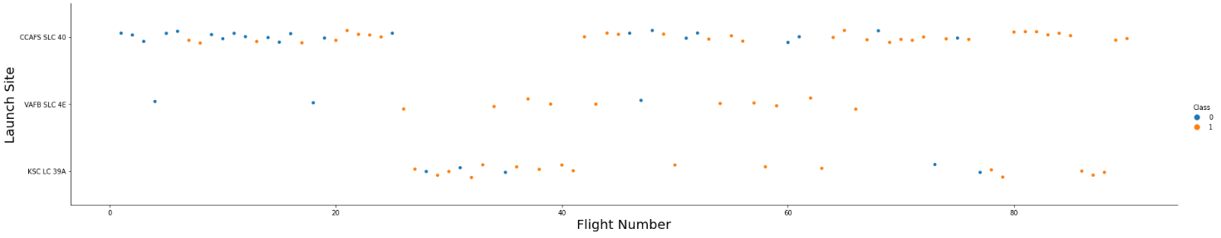
Flight Number vs. Launch Site
As the flight number above 80 all launches identify as class 1 (yellow dot) which mean success launch.

Slide 19
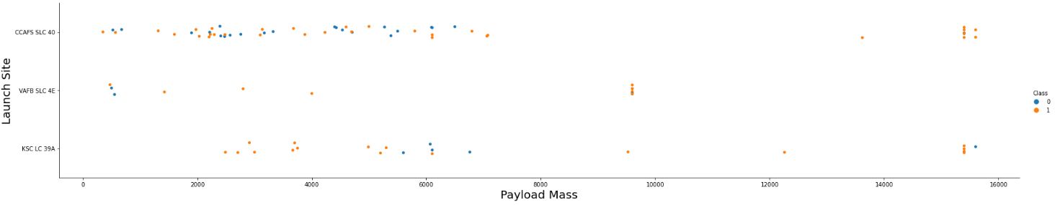
Payload vs. Launch Site
Now if you observe Payload Vs. Launch Site scatter point chart you will find for the VAFB-SLC launch site there are no rockets launched for heavy payload mass(greater than 10000).

Slide 20
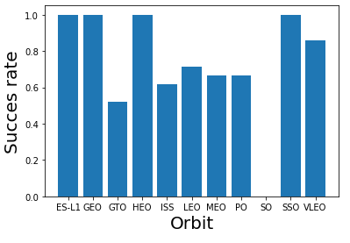
Success Rate vs. Orbit Type
We can see ES-L1, GEO, HEO, and SSO orbit type had 100% success rate.
On the other hand SO orbit had 0% success rate.

Slide 21
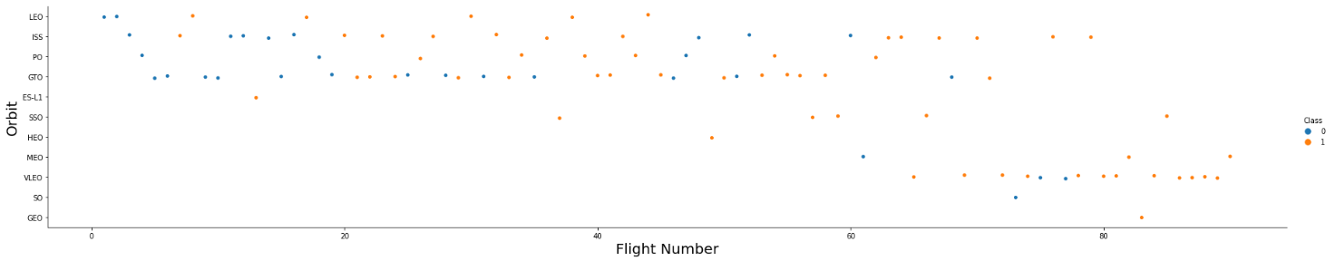
Flight Number vs. Orbit Type
You should see that in the LEO orbit the Success appears related to the number of flights.
on the other hand, there seems to be no relationship between flight number when in GTO orbit

Slide 22
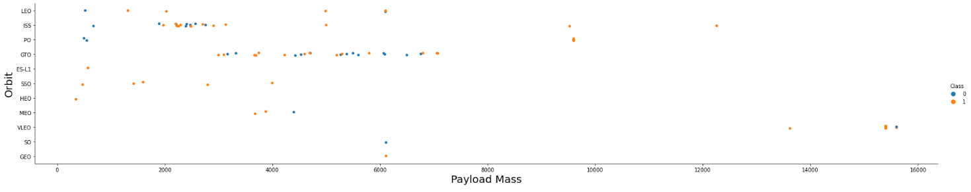
Payload vs. Orbit Type
With heavy payloads the successful landing or positive landing rate are more for Polar, LEO and ISS.
However for GTO we cannot distinguish this well as both positive landing rate and negative landing(unsuccessful mission) are both there here.

Slide 23
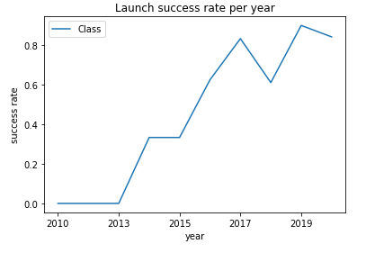
Launch Success Yearly Trend
From Yearly success rate we got Space X success launch rate increase from 2013.
And kept increasing until 2020.

Slide 24
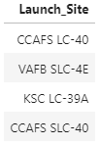
All Launch Site Names
Here is All launch sites name on SPACEX data

Slide 25
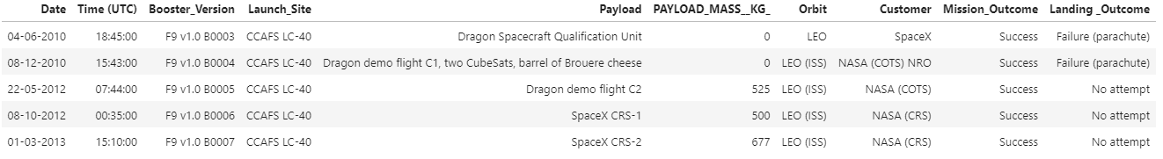
Launch Site Names Begin with 'CCA'
Showing list of 5 First Launch Site which Begin with 'CCA'

Slide 26
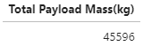
Total Payload Mass
Total Payload Mass was carried by NASA (CRS) is 45596 kg.

Slide 27
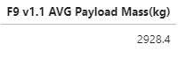
Average Payload Mass by F9 v1.1
Average Payload mass for F9 v1.1 is 2928.4 kg.

Slide 28

First Successful Ground Landing Date
From data gather we got, SpaceX First successful Ground Landing happen on 1 May 2017.

Slide 29
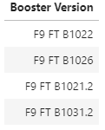
Successful Drone Ship Landing with Payload between 4000 and 6000
Booster Version F9 FT be the most success drone ship landing between 4000 and 6000 Payload mass.

Slide 30
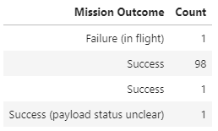
Total Number of Successful and Failure Mission Outcomes
Almost All Mission Outcome count as success, only 1 failure happen what fascinating.

Slide 31
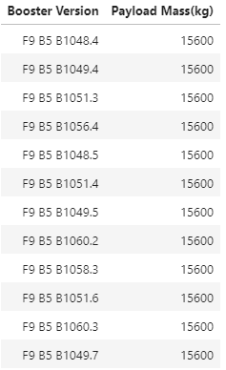
Boosters Carried Maximum Payload
Booster Version F9 B5 carried all maximum payload

Slide 32
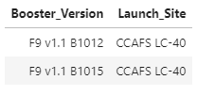
2015 Failed Launch Records
On Failed Launch Records shown on 2015 shows:
Booster Version F9 v1.1 and Launch site CCAFS LC-40 it could be the problem in Failed Launch

Slide 33
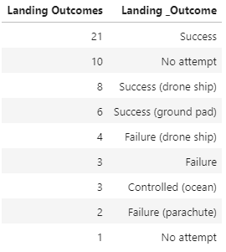
Rank Landing Outcomes Between 2010-06-04 and 2017-03-20
From table on the right, it show Landing outcomes between 4 June 2010 and 20 march 2017.
Between that date we can infer in a lot of success landing happen only a few fail happen between that 7 year .

Slide 34

Section 3

Slide 35
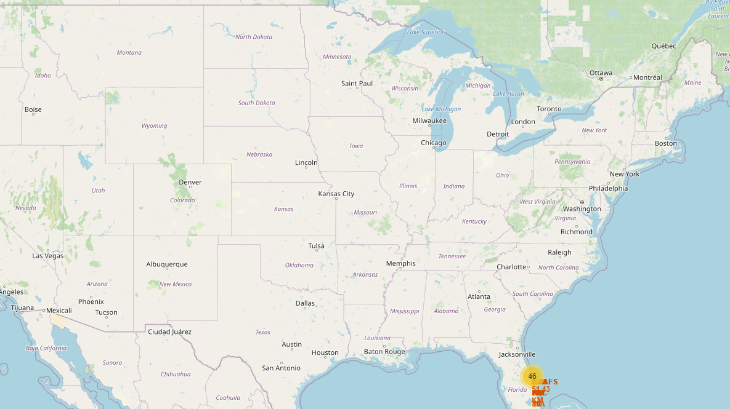
Launch Site Map
Here is Launch Site on U.S. map.
Launch site separate into 2 major side, East Coast and West Coast.

Slide 36
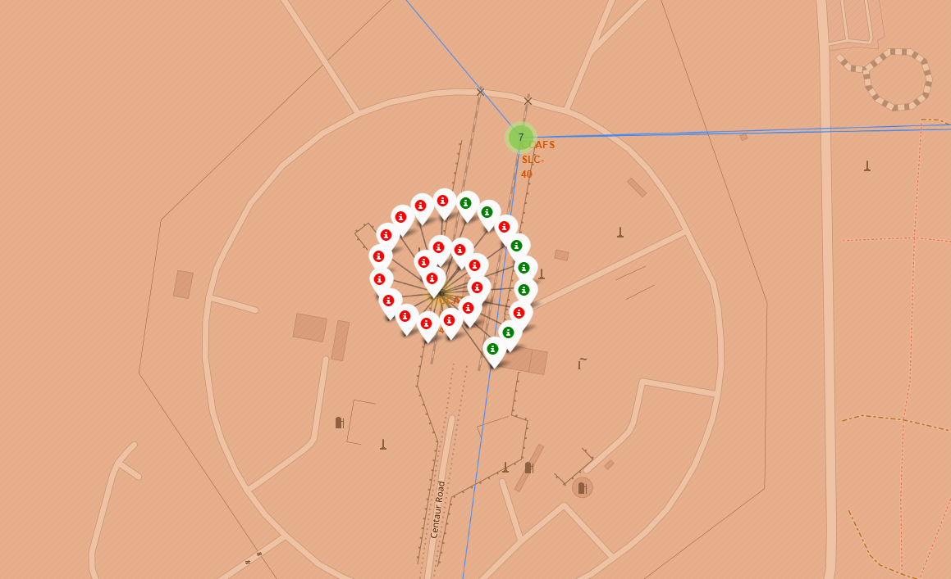
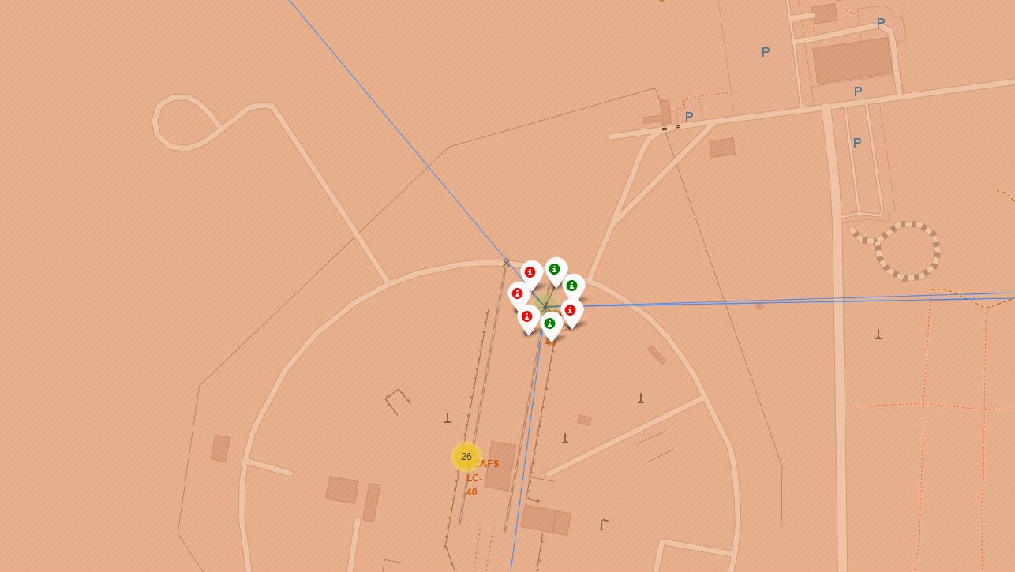
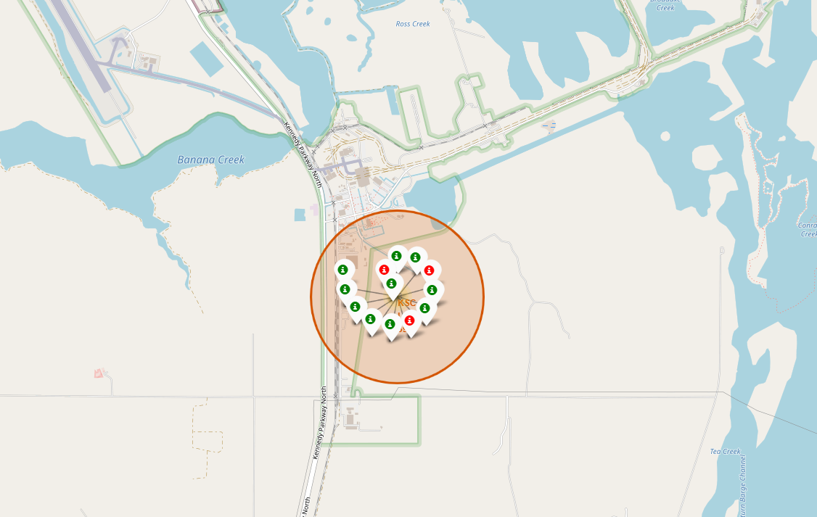
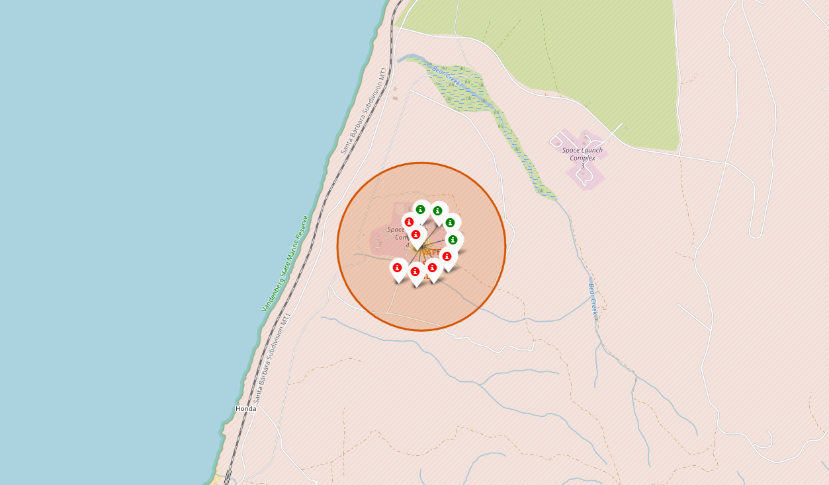
Launch Outcomes each Sites
CCA SLC-40 | CCA LC-40
KSC LC-39A | VAFB SLC-4E
Here we got Launch Outcomes on every Launch Sites
CCA SLC-40 had the Least Launch Success
KSC LC-39A had the Most Launch Success

Slide 37
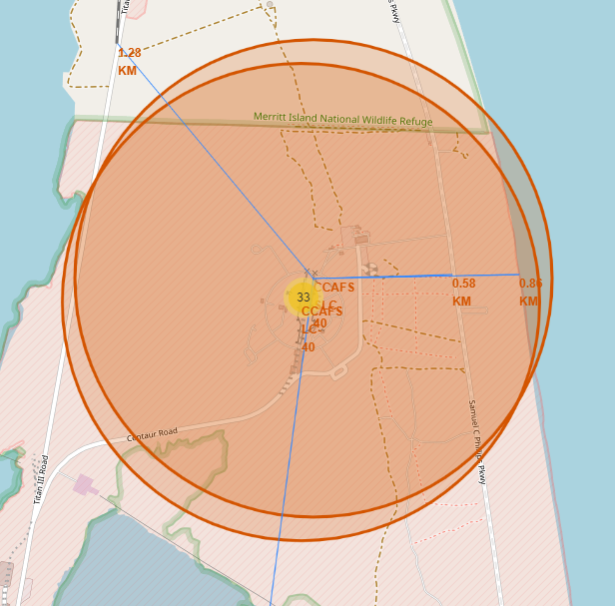
Launch Site Proximity
We got from example of Launch site CCAFS SLC-40
The Launch Site got proximity about 1.28 KM on nearby railroad
0.58 KM Proximity from nearby Highway
And 0.86 KM form the nearby coast

Slide 38

Section 4

Slide 39
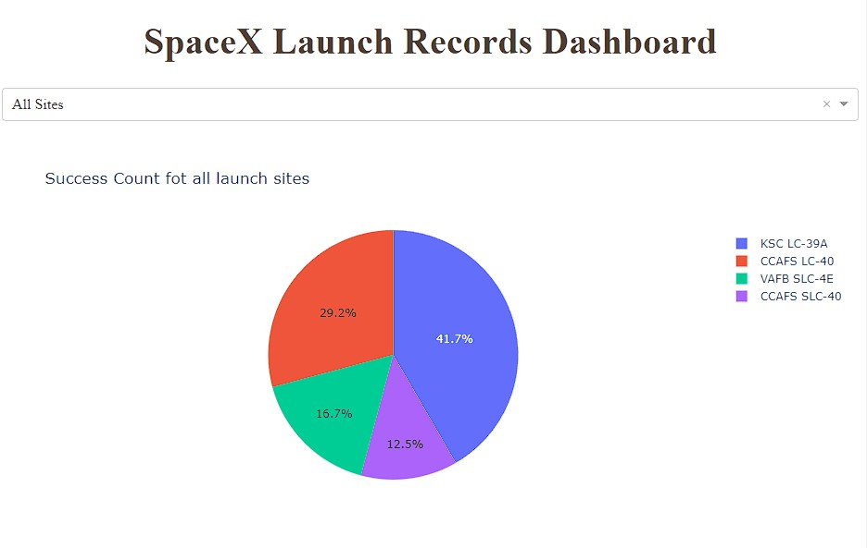
Launch Success
From Pie chart Dashboard of All sites launch Success we got KSC LC-39A had highest launch success rate with 41.7%
On contrary CCAFS SLC-40 had the lowest launch success rate with 12.5%

Slide 40
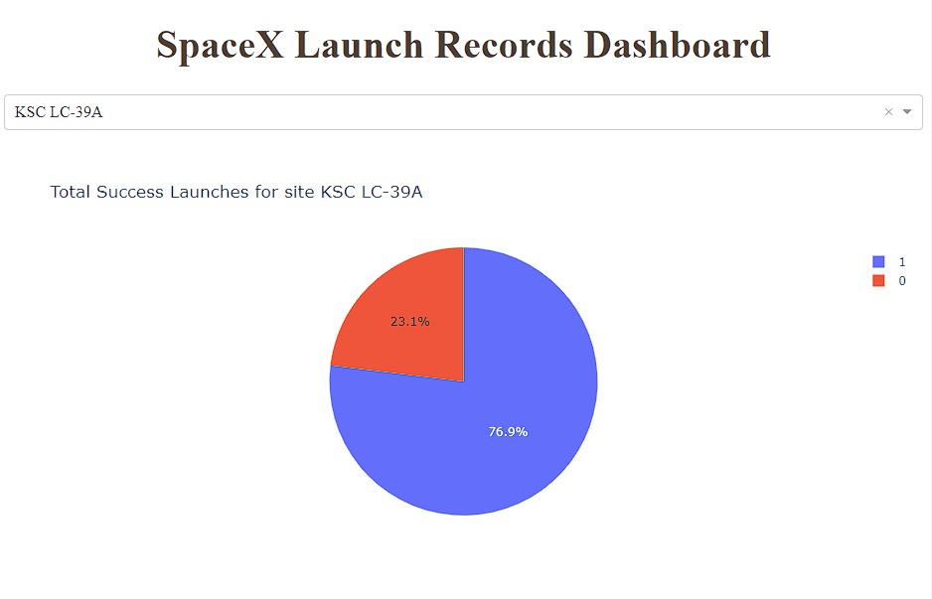
Launch Success (KSC LC-39A)
When we focus on site KSC LC-39A as the highest success rate
We got it had 76.9% success rate in total and 23.1% failure rate which fascinating

Slide 41
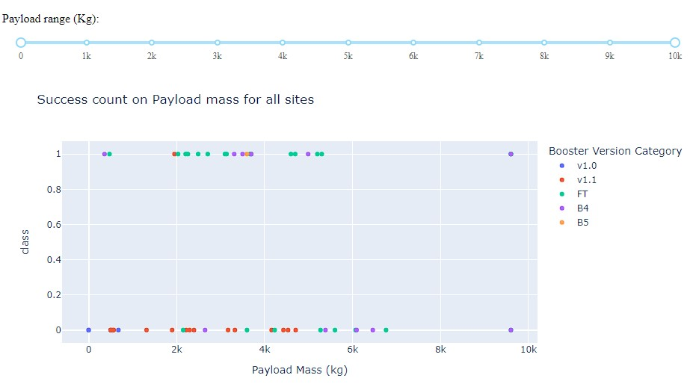
Payload vs Launch Outcome
This show initial condition when we want to show related between Payload range (kg) and Booster Version on Succes Rate (class = 1)
We would try to slide the slider and see want the relation and tell the best success rate on which Payload range and Booster Version.

Slide 42
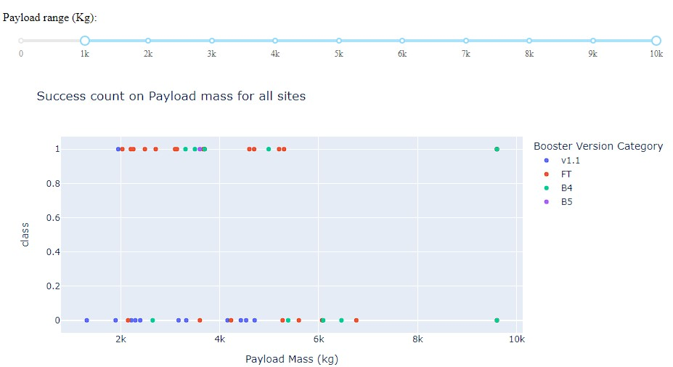
Payload range (1k – 10k)

Slide 43
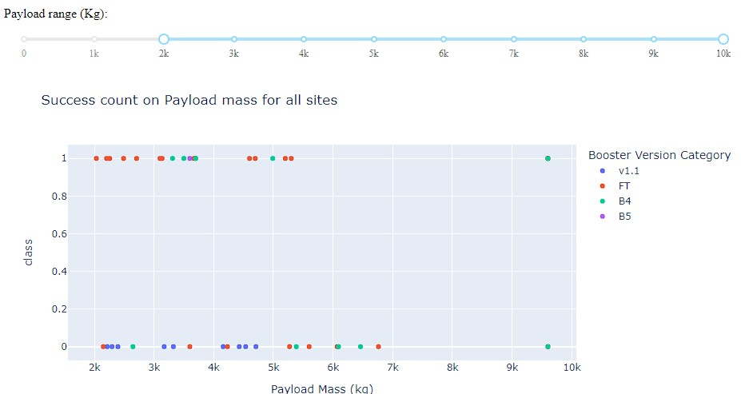
Payload range (2k – 10k)

Slide 44
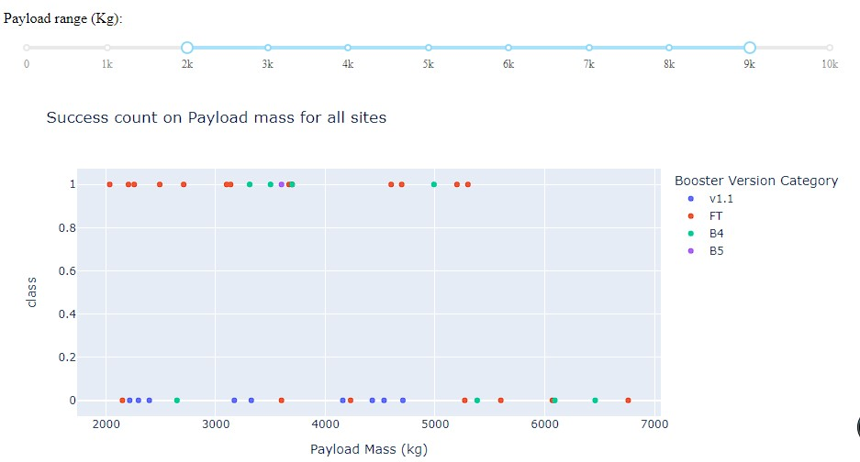
Payload range (2k – 9k)

Slide 45
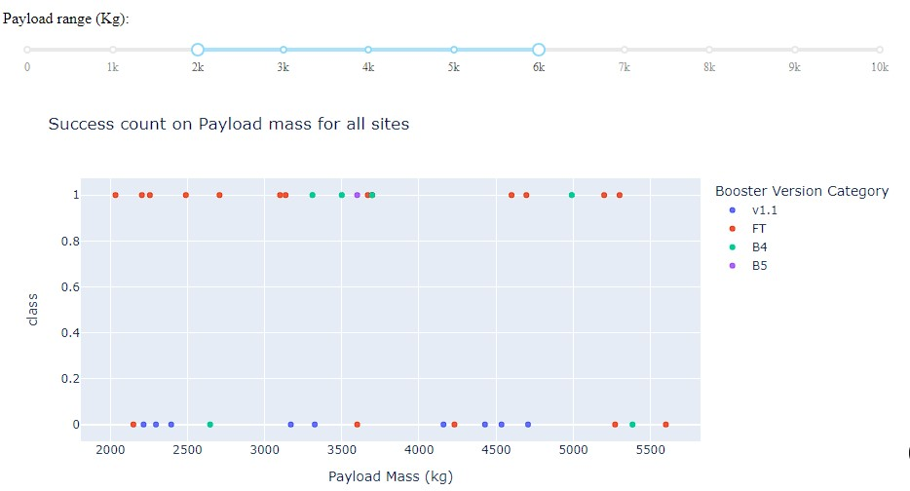
Payload range (2k – 6k)

Slide 46
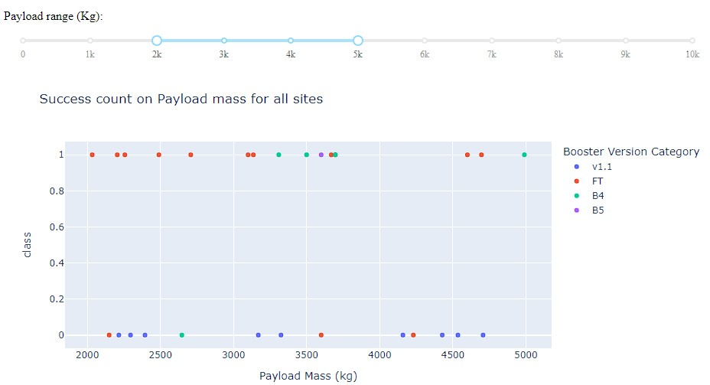
Payload range (2k – 5k)

Slide 47
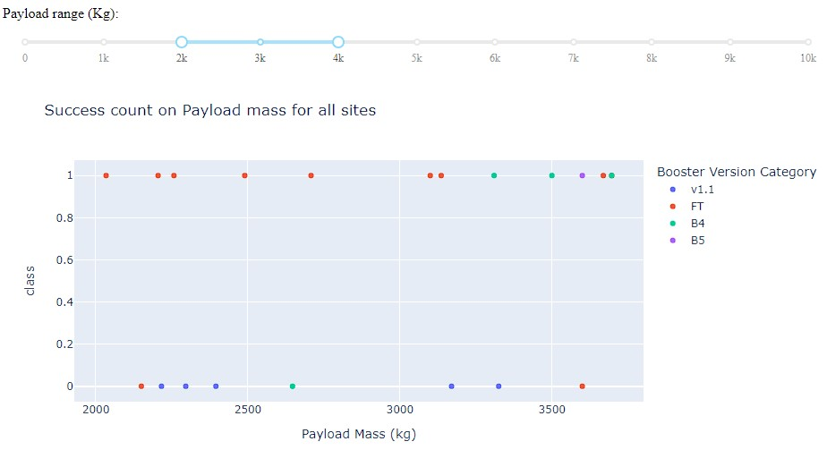
Payload range (2k-5k)
We can infer Payload range 2k-5k is the optimize size payload for success land
As the payload range max lower the failure rate count reduce
And can we infer on this optimize payload range FT Booster Version had the highest success count.

Slide 48

Section 5

Slide 49
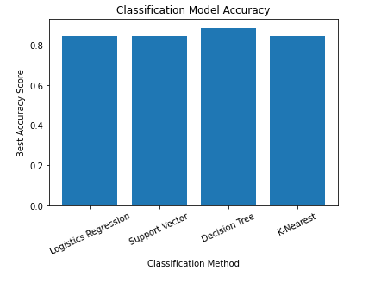
Classification Accuracy
Even there is slightest different best score on every Classification method
Decision Tree had the highest best accuracy classification with 0.8889 or equal to 88.89% Accuracy

Slide 50
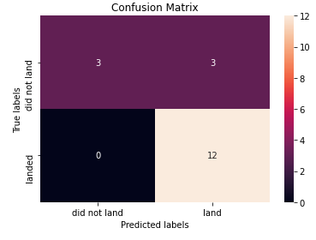
Confusion Matrix (Decision Tree)
The result from Confusion matrix of Decision Tree show the Model Predict 3 'did not land' and True Labels so showing 100% accuracy on 'did not land'
The model predict 12 'land' and so the True result but predict 3 on did not land which false positif, showing 80% accuracy on 'land'

Slide 51

Conclusions
SpaceX launch sucess rate since 2013 kept increasing till 2020.
ES-L1, GEO, HEO, and SSO orbit type had 100% success rate.
KSC LC-39A had highest success rate with 76.9% success rate and it seen on the map too.
Payload range 2k-5k is the optimize size payload for success land with FT Booster Version had the highest success count.
Decision Tree had the highest best accuracy classification with 0.8889 or equal to 88.89% Accuracy.

Slide 52

Appendix
All Python code snippets, SQL queries, charts, Notebook, or data sets used in this Project saved to this Github link.

Slide 53


